Slide 1
LT US Inventory Cost Change Summary
March to June 2025 | R401 vs R402

Slide 2
Total Inventory Change
Total Inventory Cost Change (March to June): $-840,611.72

Slide 3
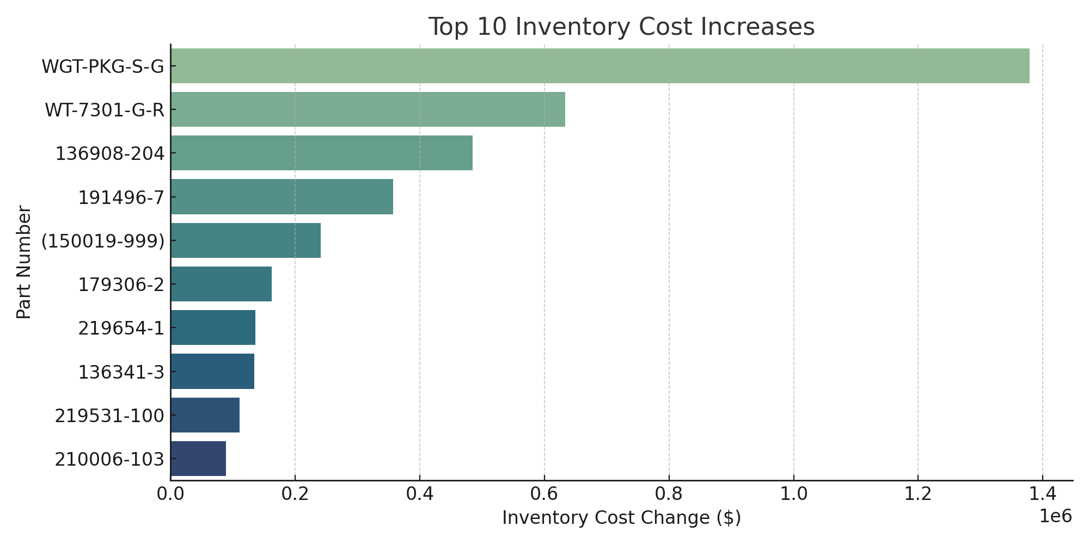
Top 10 Inventory Cost Increases

Slide 4
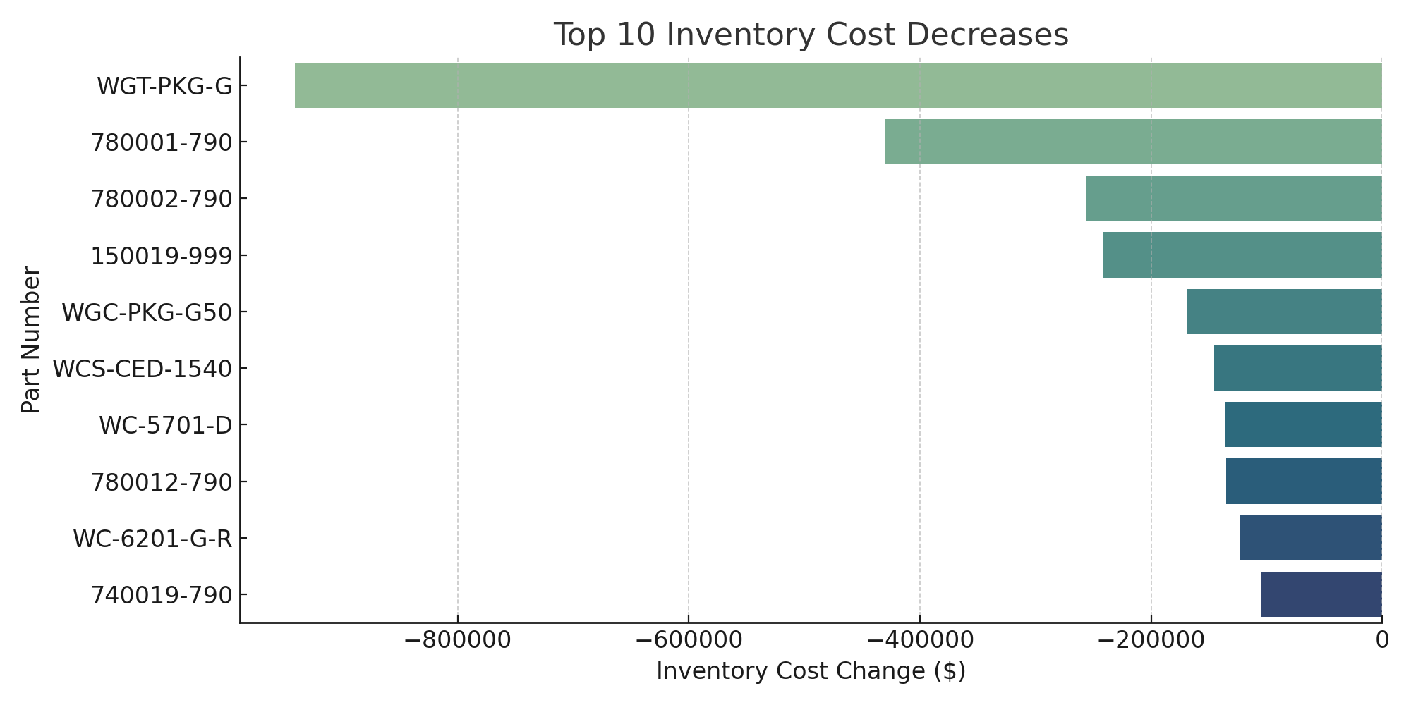
Top 10 Inventory Cost Decreases

Slide 5
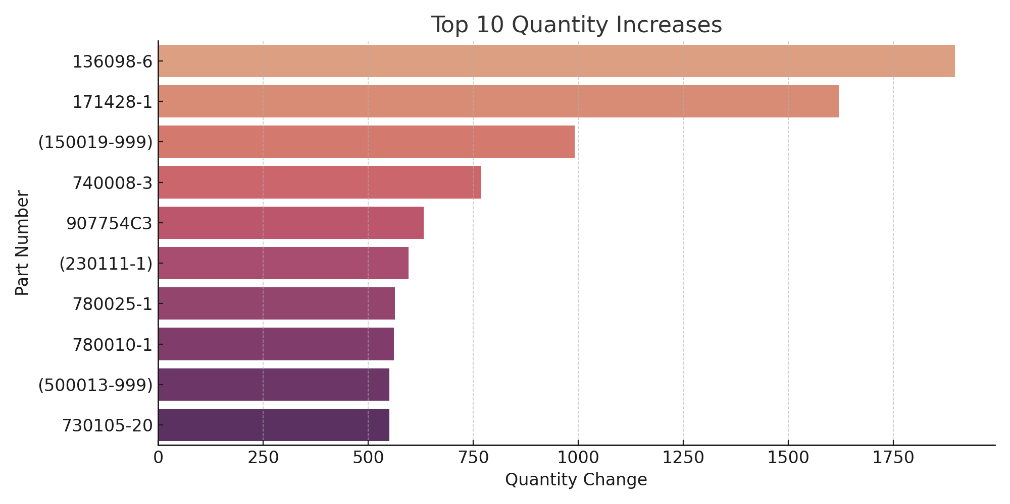
Top 10 Quantity Increases (March → June)

Slide 6
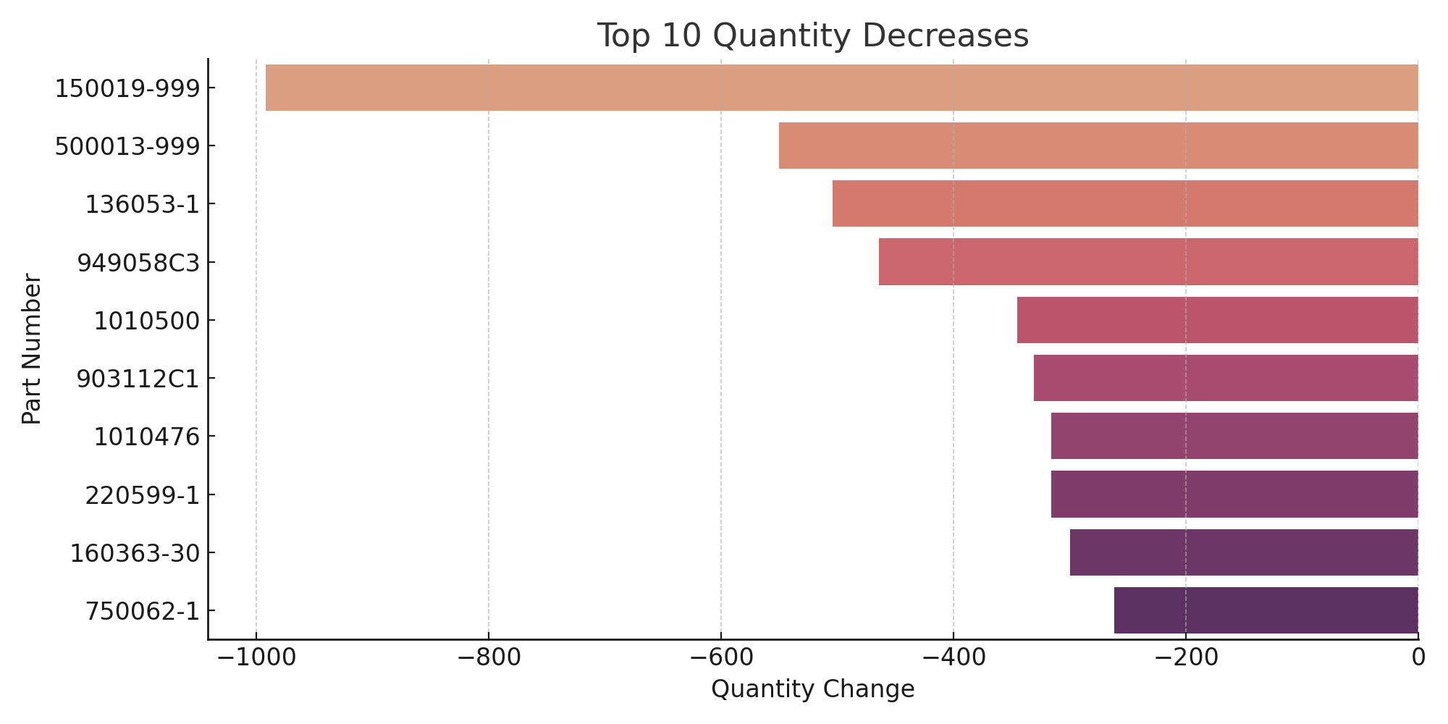
Top 10 Quantity Decreases (March → June)

Slide 7
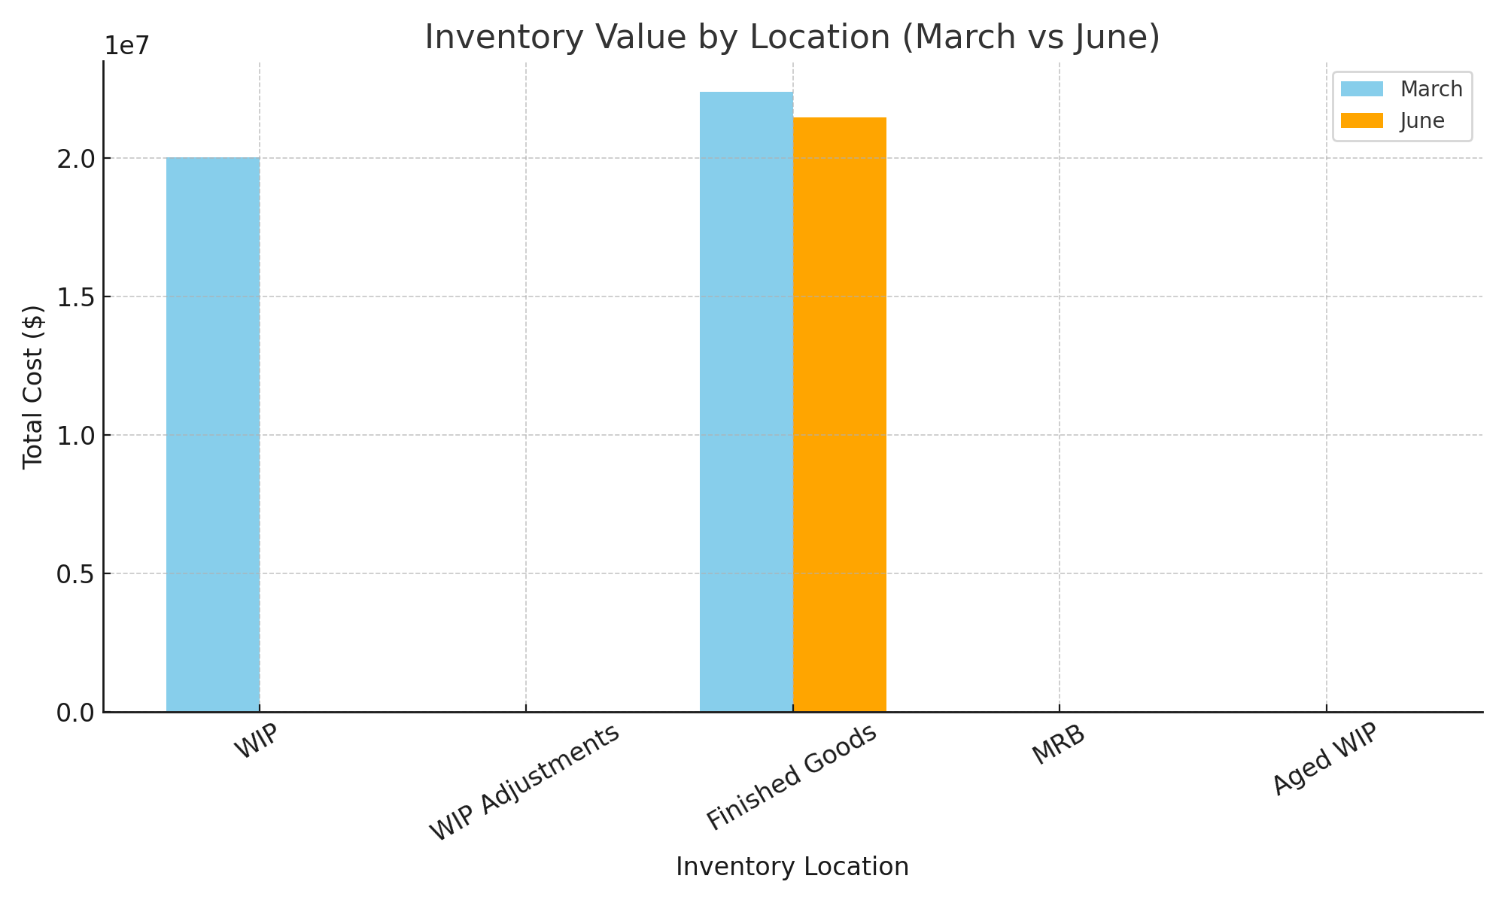
Inventory Cost by Location (March vs June)

